Slide 1
Deer Valley Resort
The Signature Collection

Slide 2
Deer Valley Plaza

Slide 3
Not your average lodging property..
Limited hours @ front desk- 7:00 AM-11:30 PM
Metal keys (not key cards)
Units are located all throughout Deer Valley

Slide 4
Rental Properties
About 150 private homes & condominiums
Smallest unit = 1 bedroom condo
Largest unit = 7 bedroom home
Deer Valley Signature Collection

Slide 5
Things we offer..
Daily housekeeping service
Complimentary transportation within 4 miles
Concierge services
Ski shuttle to transport guests to the lifts

Slide 6
Check in process
Swipe credit card in case of incidentals
Explain policies & procedures
Distribute keys
Confirm with housekeeping that the unit is ready
Enroll guest in Kipsu

Slide 7
Kipsu

Slide 8
Challenges of Kipsu
Delayed message time
System can crash
Conversation time is significantly longer than a phone call
Messages can only be received during front desk hours
Guests would attempt to contact us by calling the Kipsu number

Slide 9
Positives of Kipsu
Convenient for guests
Less phone calls
Simple to go back & reference messages

Slide 10
Cadillac Service

Slide 11
Cadillac Service
Guest may book up to 24 hour in advance
Can be driven within 4 miles of the resort
Complimentary service
Booked in 15 minute increments
If guest is 5 minutes late for scheduled ride the driver may leave

Slide 12
Cadillac Service Challenges
Large groups can abuse the privilege
Guests are late for their scheduled rides
Sundance & holiday traffic delayed rides

Slide 13
Front Desk Challenges
No hot water
Too many guests
Hot tubs
Unsatisfied with the interior/décor

Slide 14
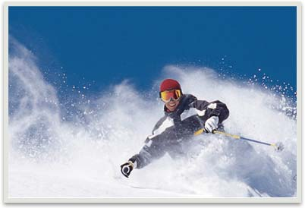
First Class Skiing

Slide 15
Amazing Cuisine

Slide 16
Unbeatable Lodging

Slide 17
Top Notch Grooming

